Slide 1
Reducing unfairness in learning algorithm applications
Module 4

Slide 2
Announcement
Final exam date: Sat Dec 14 2024 | 08:30 am

Slide 3
Learning outcomes
Discuss the consequences of erroneous (biased) data on the training of learning algorithms and how it impacts its end users
Discuss potential ethical implications in errors in feature selection, model selection
Describe strategies for reducing algorithmic bias
Apply strategies to reduce unfairness in a predictive model trained on an unbalanced dataset
Describe advantages and limitations of the strategies used to reduce unfairness in predictive models

Slide 4
Working with bias
In Module 3, you have seen how bias in datasets can result in unfair models
Can we curb the effects of a biased dataset?
In this module, you will work on the Kaggle Adult Income Dataset. This dataset is known to be biased towards certain groups. Specifically, some groups are more likely than others to be assigned one of the two target values (income greater or lower than $50k)
Why is this a problem?

Slide 5



A closer look at the data
Age
Marital status
Occupation
…
The dataset includes fewer women earning more than $50k than men
Notes:
It would be very easy for the algorithm to learn that if a person is a woman, they are likely to make less money.
What kind of bias is this?

Slide 6
Undersampling
To fix the unbalance, we can try to select a more balanced subsample
Issues?
Will this work?
Men >$50k
Men <=$50k
Men >$50k
Women >$50k
Men <=$50k
Women <=$50k
Women >$50k
Women <=$50k
Notes:
Issue: you will lose training samples
It may work, unless other characteristics highly correlated with being a woman can lead to learn the same rule.

Slide 7
Oversampling
The counterpart of undersampling is oversampling, which can be achieved in different ways:
By resampling (replicating) samples from the original training set, or
By introducing artificial new samples, which should be similar enough to those included in the original training set
Women >$50k (will include duplicates)
Sampling with replacement
Women >$50k

Slide 8
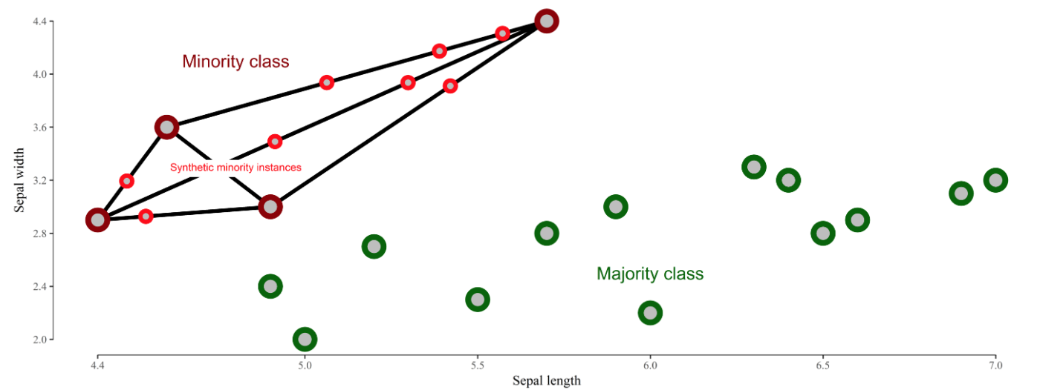
Synthetic Minority Oversampling Technique (SMOTE)
More advanced technique to augment the dataset with new data (but no duplicates)
from http://rikunert.com/SMOTE_explained

Slide 9
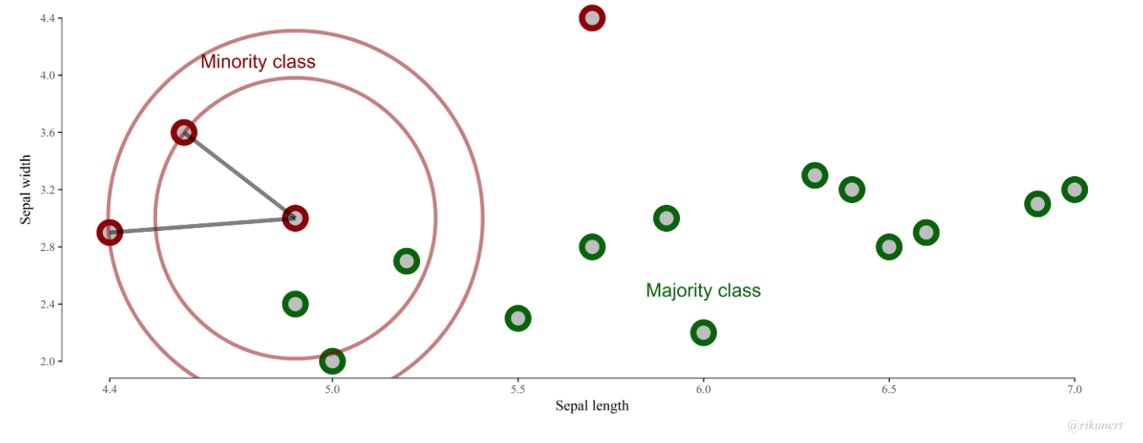
SMOTE with different k
Watch out! The goal of SMOTE is to balance the target variable, not the groups!
In this case, we expect it to create a few more samples of women making >$50k
Notes:
Another option would be to use first SMOTE, then undersampling.

Slide 10
Adversarial debiasing
f₁ | … | f_{P} | f_{N}
Predictions
f_{P}
Model A
Model B
Model A gets a penalty every time Model B is able to correctly guess f_{P}
Reading (optional): Mitigating Unwanted Biases with Adversarial Learning

Slide 11
Equalized odds postprocessing
As name suggests, it is a post-processing technique
Predictions of any given classifier can be changed to meet certain fairness criteria, in this case, equalized odds (TPR and FPR on par across groups)
Source: https://arxiv.org/abs/1610.02413

Slide 12
Get inspired
Other people have been trying approaches to de-bias the Adult Income dataset!
In particular, you may be interested in this tutorial.
Disclaimer: the tutorial is very similar, but not identical, to our Assignment 4. You will not find the solution there!

